Slide 1
Lecture 7

Slide 2
Models for Network Security

Slide 3
Outlines
Model for network security – chapter 1
Introduction to symmetric encryption – chapter 2

Slide 4
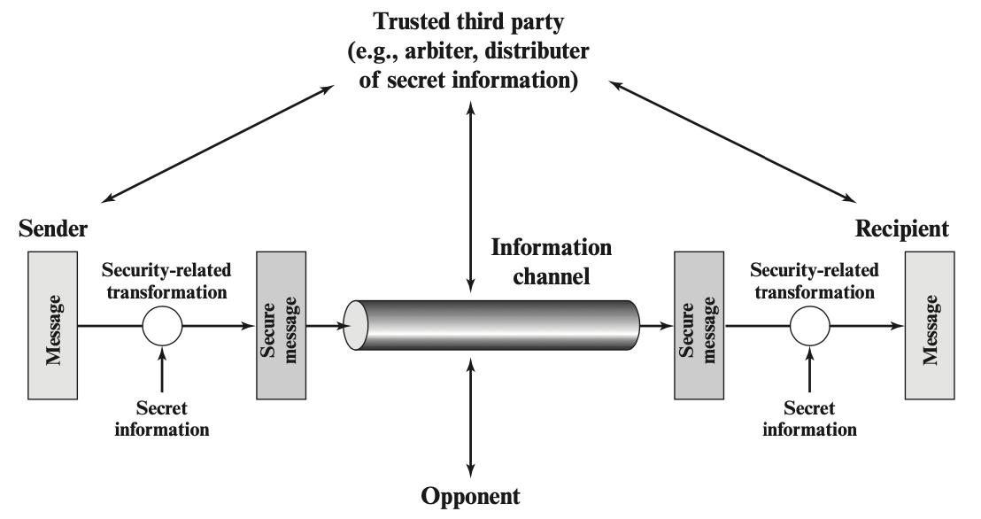
Model for network security

Slide 5
Model for network security
Using this model requires us to:
design a suitable algorithm for the security transformation
generate the secret information (keys) used by the algorithm
develop methods to distribute and share the secret information
specify a protocol enabling the principals to use the transformation and secret information for a security service

Slide 6
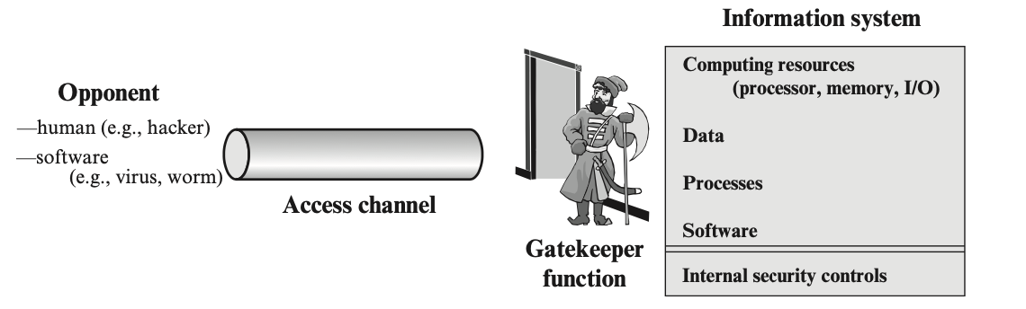
Model for Network Access Security

Slide 7
Model for network access security
Using this model requires us to:
select appropriate gatekeeper functions to identify users
implement security controls to ensure only authorized users access designated information or resources
Trusted computer systems can be used to implement this model

Slide 8
Standards: supplementary materials
Internet Security Glossary, v2 – produced by Internet Society https://datatracker.ietf.org/doc/html/rfc4949
NIST, Cybersecurity Framework
https://www.nist.gov/cyberframework
Federal Information Processing Standards (FIPS) - a set
X.800 – OSI network security
https://www.itu.int/rec/dologin_pub.asp?lang=f&id=T-REC-X.800-199103-I!!PDF-E&type=items

Slide 9
Summary for Chapter 1
Have learned:
Security requirements
Attack models
X.800 secure architecture, security services, mechanisms
models for network security

Slide 10

Review Questions
William Stallings (WS), “Network Security Essentials”, 6th Global Edition
RQ 1.1 - 1.6
Prob 1.5

Slide 11
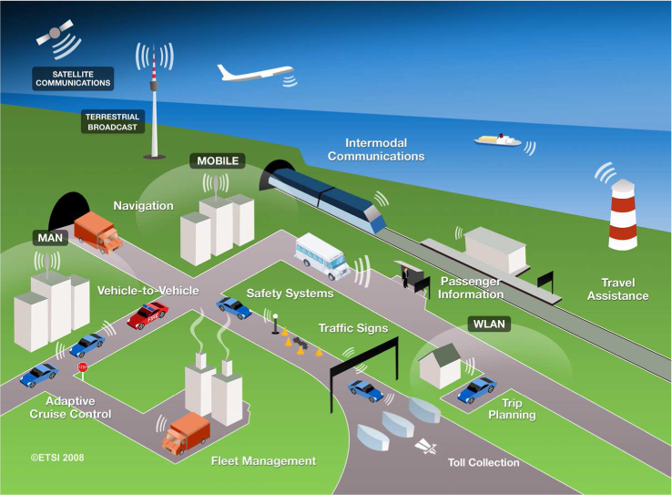
Paper Review 2: Transportation Network Security
Types of communication networks
vehicle to vehicle (V2V)
vehicle to pedestrian/human (V2P)
vehicle to infrastructure (V2I)
infrastructure to pedestrian/human (I2P)
vehicle to everything (V2X)
Causes of security issues
pedestrian accidents / safety issues
Review 1 – pedestrian safety
collisions / emergencies / attacks
Review 2 - ITS network security

Slide 12
Paper Review 2
Deadline: Feb. 10th, Friday, 11:59 pm
Will be announced on the blackboard this morning.
Only one member per group to submit the review.

Slide 13
TA’s and Grader’s Office Hour
Name: Pallavi Zambare (TA)
Office: CS204A
Email: pzambare@ttu.edu
Hours: Wednesday 11:00 am to 12:00 pm or by appointment
2. Name: CharanTej Chetty
Office: CS204A
Email: Charantej.Chetty@ttu.edu
Hours: Monday 03:00 pm to 04:00 pm or by appointment
3. Name: Wei Lin
Office: CS202A
Email: W.Lin@ttu.edu
Hours: Wednesday/Friday 2:30 pm – 3:30 pm or by appointment

Slide 14
Project Group Member : Instructions for CS_5342_001
The project will be assigned as a group project.
Six or seven students will be considered a group for the project.
A link was created for you to enter your project group member names and TTU mail. (Students may also work alone if they wish).
CS5342 PPROJECT GROUP NAMES
It is recommended that one person in the group can fill out the form to avoid multiple entries.
If you are unable to get a group by 10th Feb, please send mail to TA.

Slide 15
Project Group Member : Instructions for CS_5342_D01
It is recommended that all distance students work as one group.
Students may also work alone if they wish. (In that case, send mail to TA).

